Slide 1

PREDICTING CUSTOMER BUYING BEHAVIOUR
20/11/2022

Slide 2
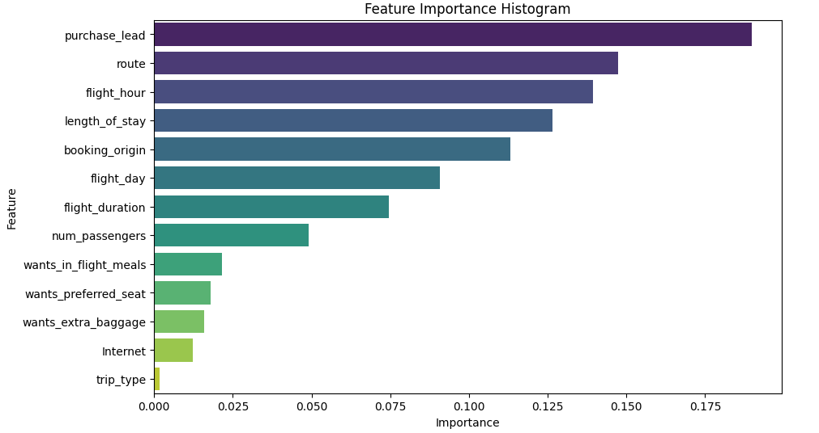
PREDICTIVE MODEL TO UNDERSTAND FACTORS THAT INFLUENCE BUYING BEHAVIOUR
We have trained the data set with Random forest classifier model and achieved
ACCURACY: 85.09
purchase_lead
route
flight_hour
length_of_stay
booking_origin
flight_day
are the top 6 features which influence
Customer buying behavior

